Slide 1
2025 Media Kit
“Let us connect you to the policy world & the key influencers across food & agriculture who connect with us, multiple times daily!”

Slide 2
Agri-Pulse Weekly Newsletter
7
Agri-Pulse Newsmakers
8
Agri-Pulse West
9
Audience Engagement Opportunities
In-person presentations
Webinars
Open Mic
Social media
Cover wraps
Banner ads
Group subscriptions
Videos/Agri-Pulse TV
Future Ag Leaders
Content licensing
Conferences
Agri-Pulse Daily Harvest
10
Agri-Pulse.com
11
Agri-Pulse Daybreak
12
Energy-Pulse Daily
13
Agri-Pulse DriveTime
14
Conferences
15
Webinars
16
Rates & Specifications
17
Contact Us
18

Slide 3
Thank You…
...for your interest in Agri-Pulse Communications, Inc., the most trusted and leading source for agriculture and rural policy news and analysis.
I’ve had a keen interest in agricultural policy going back to my days growing up on the farm in Iowa when my dad would invite our congressman over for dinner and dialogue. I continued to be engaged in covering farm policy issues throughout my career as a journalist.
Launched in 2004, today, “Agri-Pulse is the largest, most experienced ag policy news bureau, with offices in Washington, D.C., and Sacramento, CA.” We reach the ag policy opinion leaders, key influencers and marketing executives across the U.S. and around the world who impact ag & food policy.
Sara Wyant
President
(630) 247-7142
Sara@Agri-Pulse.com
We hope you will also become a fan of our coverage and choose to use one of our products to help your organization communicate with Capitol Hill, government agencies, agribusiness executives, financial institutions, or the leadership of the top farm and commodity organizations.
Please feel free to contact me or any of our staff members.
Sincerely,

Slide 4
Who We Are…
Ag, Food & Rural Opinion Leaders
Federal legislators & staff involved in agriculture, food & energy
Governors and state ag department staff in all 50 States
“C-Suite” & ag policy-minded executives in agri-business, farm retail/co-ops, energy & food industries
Farmer leaders & staff serving farm commodity, marketing, promotion & trade organizations
Ag, food & rural policy influencers across the U.S.

Slide 5
What We Do…
Cover all policy aspects of the food, fuel, feed & fiber industries
Inform our readers about ag policy decisions made in Washington D.C., Sacramento, CA and across the U.S. that impact their productivity, their businesses and their bottom line!
Agri-Pulse is the largest, most experienced news bureau in the U.S. dedicated 100% to covering ag & food policy issues

Slide 6
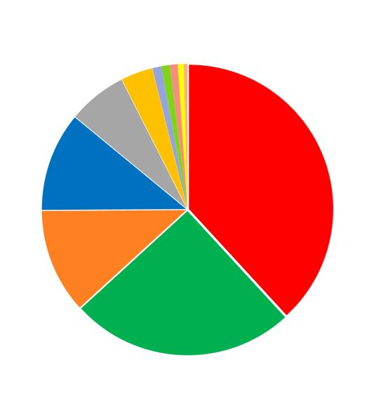
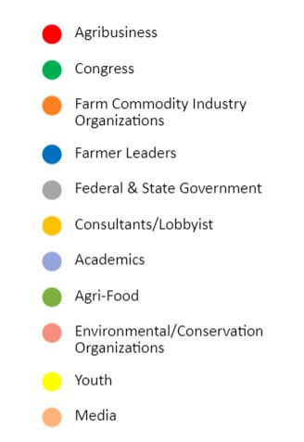
Subscriber Profile Reaching more than 10,000+ influencers!
79%
of Agri-Pulse circulation is outside the D.C. beltway.
21%
in the Beltway

Slide 7
Group Subscription Pricing at Substantial Discounts
Subscriptions
Price
The most trusted & reliable source for in-depth ag & food policy news & analysis
1
5
10
15
20
25
30
$837
$3,037
$5,337
$7,647
$9,907
$12,017
$13,907
Distributed each week coast to coast to 10,000+ key influencers
Subscription includes:
Weekly newsletter
Daily Harvest
Instant Updates
Daybreak
DriveTime
Newsmakers
Full website access
Discounts on admission to Agri-Pulse events
Annual special reports
50
100
200
200+
$20,887
$35,817
$62,567
Quote Available
Greetings,
Happy Wednesday, where we are watching congressional Democrats navigate a newer version of their $3.5 trillion Build Back Better package – trying to figure out what gets scaled back or eliminated. Senate Ag Committee Chairman Debbie Stabenow assured us that the bill would still “have something meaningful” when it comes to addressing climate-smart agriculture and forestry, even as the spending range now looks more like $1.9 trillion to $2.2 trillion.
In this week’s newsletter, we look at how funding from the Commodity Credit Corporation is increasingly being used to carry out policy priorities for this administration (and the last one, too). Philip Brasher talked to several insiders about how goals have changed over time and what key lawmakers are saying about how the CCC is being used.
For those of you interested in sustainability, especially as it relates to soybeans, I hope you’ll join us for a free webinar Thursday at 11 a.m. central time. You’ll hear from soy leaders representing the United Soybean Board, American Soybean Association and U.S. Soybean Export Council about how U.S. growers are responding to new expectations from international customers and what it might mean for future export opportunities. You can register by clicking here.
Best regards,
Sara Wyant Editor/Publisher Agri-Pulse Communications, Inc. Sara@Agri-Pulse.com Follow Us: ::Twitter:: Like Us: ::Facebook:: Agri-Pulse – Balanced Reporting. Trusted Insights.
Cover Wraps
A group of fifty or more subscriptions qualifies for a cover wrap promotional page, delivered each week at the top of the Agri-Pulse e-newsletter to that organization’s sponsored subscribers. No additional charge!
See page 17 for cover specifications
Greetings,
As we reported earlier this morning in reform and you can count on us to
Agri-Pulse Daybreak, today’s big focus is on tax
provide more details as soon as the White House lifts the thus far. Look for President Trump to mention
usinessmen during his speech today in Indianapolis.
| Volume 13, Number 37
ull Edition
bill funding, but at political cost
farm bill, they’re strapped for the cash they need to
awsuits
nationwide are likely to get a payment as the result of a premature commercialization of a genetically
corn imports in 2013.
ut fall below targets
urning their soil into a kind of sponge and absorbing cereal rye and varieties of radish during harvest
and increase yield.
TPA =
Jobs
embargo on the outline they’ve provided
Bacon +
U.S. J
Indiana farmer Kip Tom and other b
Sara Wyant Editor/Publisher
Agri-Pulse Communications, Inc.
September 27, 2017
Read F
Updating base could help farm
As lawmakers prepare to write the next cover a long list of demands.
Syngenta settles corn growers' l
As many as 350,000 corn growers settlement of lawsuits alleging Syngenta’s
October 06, 2021 | Volume 17, Number 38 Click here to read the full edition as a PDF
engineered trait caused China to reject U.S.
Cover crops gain momentum, b
USDA’s CCC takes on big role as presidents look to fund priorities Successive presidents have ramped up use of a Depression-era tool, USDA's Commodity Credit Corp., to pour billions of dollars into their policy priorities with limited input from Congress. Republicans, who handcuffed Ag Secretary Tom Vilsack's use of the CCC for years, are less resistant now.
Farmers from Maryland to Illinois are t the benefits: Planting cover crops such as
Nearly 30% of the pork produced in America is exported, supporting 147,000 U.S. jobs, because of free trade agreements. Free trade doesn’t happen without
season can simultaneously enhance the soil
'Middle ground' on WOTUS elusive if not impossible EPA Administrator Michael Regan has said repeatedly he wants to craft a “durable” definition of “waters of the United States” in the Clean Water Act — one informed by Supreme Court precedent and input from a variety of stakeholders.
Trade Promotion Authority (TPA).
It’s time for Congress to put petty politics aside and renew TPA. It’s an economic issue, not a partisan one.
For more information, go to: www.nppc.org/issues/international-trade
USDA bets big on OIE to help protect US pork trade amid ASF fears The U.S. is counting on an expensive campaign to protect nearby territories from African swine fever as well as international respect for the World Organization for Animal Health to protect American pork production and exports.
Paid for by the National Pork Producers Council.
Virtual fencing allows producers flexibility for cattle grazing It can be costly and time-consuming for ranchers to keep their cattle inside the pasture using just traditional and electric fencing, but researchers are looking into a possible virtual solution.

Slide 8
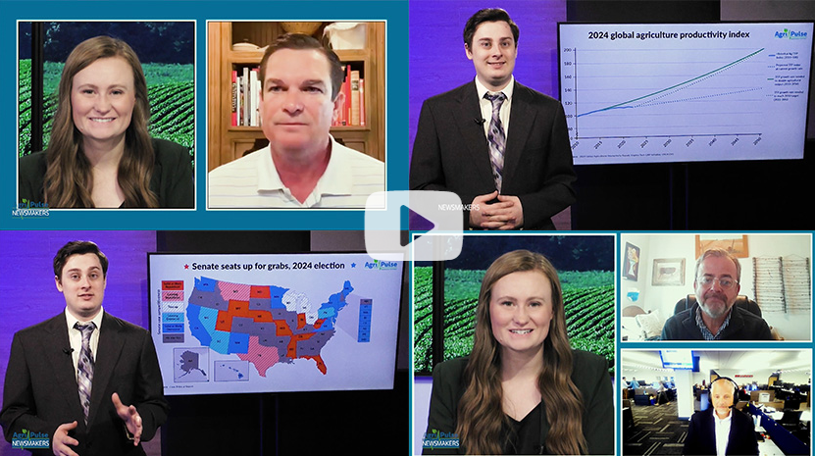
Launched in February 2022, presented weekly each Friday
A 30-minute video/podcast news show created to reach a broader audience base and engage key influencers on the hottest political topics each week
Agri-Pulse Newsmakers features members of Congress, federal and state officials, farmers, ag and food industry groups and roundtable panelists for debates and discussions
Commercial sponsorships available in :30 or :15 formats, Agri-Pulse only or in combo with RFD TV
Appears on Agri-Pulse.com, YouTube, Google Play, iTunes, social media platforms & additional sponsor channels…currently generating 20,000+ views weekly…plus additional 50,000 RFD TV viewers
Now Appearing on…

Slide 9
Agri-Pulse West
2,000+ Western Grower members, 115+ CFBF staff, 300+ legislative staff & more
Editorial & sales staff based in Sacramento, dedicated to California & western U.S. agriculture
Weekly newsletter, Daybreak, Daily Harvest, & Instant Updates focused on western ag & food policy issues
A special “West” tab is included on www.Agri-Pulse.com
Group & individual subscriptions available
Annual Agri-Pulse WEST Food & Ag Issues Summit: Sacramento, CA, June 10, 2025
Sacramento
Contact Burke Kennedy, Western Sales Associate, at burke@agri-pulse.com

Slide 10
A must-read resource for anyone needing to stay current on the latest ag & food policy news
Daily email blast of breaking news aggregated from Agri-Pulse & other leading sources
Banner Ad Pricing
Type
Monthly Price
Leaderboard Banner West Leaderboard Banner Daily Harvest Combo* *Both regular and West versions included | $6,587 $3,937 $9,477
Distributed by 6:00 a.m.
ET Monday – Friday
Top news regarding farm & rural policy; energy; food & nutrition; trade & international; conservation, environment & wildlife; farm labor & immigration and more.
Averaging 60-65% open rates
Circulation is 5,400+
Ad Specifications
Initial Dimensions
Ad Unit (w x h in px)
Leaderboard 728 x 90
File Types Allowed
JPG, static GIF, PNG

Slide 11
Agri-Pulse.com
O
OPINION SPONSOR BIG BOX
R
D
D
OPINION SPONSOR BIG BOX
D
D
I
D
V
E
Data from Google Analytics 1/1/2024 - 9/30/2024
Monthly Averages:
Users: 58,441
Pageviews: 210,053
TOP LEADERBOARD
NEWSMAKERS SPONSOR
Users
Page Views
525,972
1,890,481
Sessions
Avg. Session Duration
LOWER HALF PAGE
801,717
03:25
OPEN MIC SPONSOR BIG BOX
TV
AGRI-PULSE TV BIG BOX
Click here to view.
Click here to listen.
BOTTOM LEADERBOARD

Slide 12
A highly popular early-morning report about the politics, policies &
people involved in food & agriculture
Trade groups seek administration help in resolving rail conflict After another union voted not to ratify a contract with rail carriers last week, more than 300 local, state and national trade associations urged the Biden administration to work to advert a strike during the nation’s holiday season.
The Brotherhood of Railroad Signalmen rejected the agreement last week, 60-39%. “BRS members spoke loudly and clearly that their contributions are worth more, particularly when it comes to a basic right of…
Daily report with both audio and transcript (8-10 minutes) on current events in ag & food policy
Emailed Monday-Friday to subscribers by 4 a.m. ET
Daybreak-only subscriptions available
Sponsor recognition available with each daily email
Circulation is 5,900+
Click Here To Listen
# Subscriptions |  | Total cost
1 |  | $417
5 |  | $1,517
10 |  | $2,687
25 |  | $5,837
35 |  | $7,627
50 |  | $10,443
100 |  | $16,707
150 |  | $22,947
200 |  | $28,767
500 |  | $36,777
Other quotes available

Slide 13
Biofuels Agri-Pulse: White House, EPA pledging RFS commitment Link - (Audio) The Trump Administration is pledging its support for the Renewable Fuel Standard as the comment period for a controversial proposal under the plan
comes to a close. Agri-Pulse: Trump, Pruitt doing RFS outreach to Iowa officials Link - (Subscriber only) By the end of the week, one would expect EPA Administrator Scott Pruitt to be fluent in pro-RFS Iowa vernacular.
The Des Moines Register: Gov. Reynolds: Conversation with Trump on RFS was 'constructive' Link - Iowa Gov. Kim Reynolds said Wednesday she had a "very constructive" phone call with President Donald Trump about preserving a federal mandate that
requires ethanol and biodiesel to be blended into the nation’s fuel supply. Wind Engadget: World’s first floating wind farm powers up in Scotland Link - The blades of five huge turbines have begun spinning on the world's first floating offshore wind farm, located over 15 miles off the coast of Peterhead,
Aberdeenshire in Scotland. CNBC: Amazon's Jeff Bezos just opened a massive wind farm in Texas Link - Amazon’s biggest wind farm to date is operational and will add over 1 million megawatt hours (MWh) of clean energy to the grid annually.
Grid Agri-Pulse: DOE considers controversial power project opposed by lawmakers Link - Energy Secretary Rick Perry is weighing a request to end DOE's participation in a multibillion project that would carry 4,000 megawatts of electricity – enough to
power more than 1.5 million homes – across multiple states. Agri-Pulse: Perry urges FERC to make grid resiliency a priority Link - (Subscriber only) The Energy Department's directive to FERC to issue a rule that helps accurately price electricity generation was intended to spark a
conversation on the resiliency and reliability of the country's electric grid. People The EPA could soon have more of its top leadership in place. The Senate Environment and Public Works Committee was to vote today on nominees for four assistant administrator positions: Michael Dourson, Chemical Safety and Pollution Prevention; William Wehrum, Air and Radiation; Matthew Leopold, General Counsel; and David Ross, Water. If approved, the nominees will still need confirmation by the full Senate. Jim Gulliford is returning to the EPA as administrator for the agency’s Region 7, which covers Iowa, Kansas, Missouri and Nebraska. Most recently, Gulliford served as executive director of the Soil and Water Conservation Society, leading the organization from 2009-2016. Before that, Gulliford spent nearly a decade at EPA, rising to the position of assistant administrator for the Office of Prevention, Pesticides, and Toxic Substances. President Trump has picked AccuWeather CEO Barry Myers to lead the National Oceanic and Atmospheric Administration. An attorney, Myers has headed up the weather-forecasting firm since 2007. Trump had earlier filled two deputy posts at NOAA: former Navy oceanographer Rear Adm. Timothy Gallaudet and Neil Jacobs, chief atmospheric scientist at Panasonic Avionics Corporation
A morning digest of everything energy!
Aggregated headlines and links on energy issues from Agri-Pulse and other leading sources
Emailed early morning daily, Monday – Friday
Published 48 weeks per year
Delivered to 750-850 energy legislators on the Hill, & other key influencers
Each sponsor can add up to 100 names to receive Energy-Pulse Daily
Banner Ad Pricing
Position
Monthly Price
Top Leaderboard Center Leaderboard Lower Leaderboard
$1,500
$1,500
$1,500
Ad Specifications
 | Initial Dimensions | File Types
Ad Unit | (w x h in px) | Allowed
Leaderboard | 728 x 90 | JPG, static GIF, PNG

Slide 14
Agri-Pulse DriveTime
An exclusive commercial opportunity!
A daily podcast with a roundup of the day’s top headlines, delivered Monday–Friday at
5 p.m. ET, just in time for afternoon commutes
Includes an opening billboard
30-second commercial embedded
Sponsor link recognition in email*
Produced 48 weeks per year
PLUS…
Click here to listen.
…a 120x90 banner ad
on Agri-Pulse.com homepage
Delivered daily to 5,500+ listeners
Outstanding listener acceptance with over 40% open rate and averaging 50k web impressions
Weekly: $2,747
Monthly: $9,877
*Sponsor link included with full month sponsorship
(additional $500 option for weekly sponsor)

Slide 15
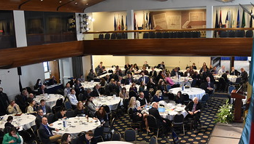
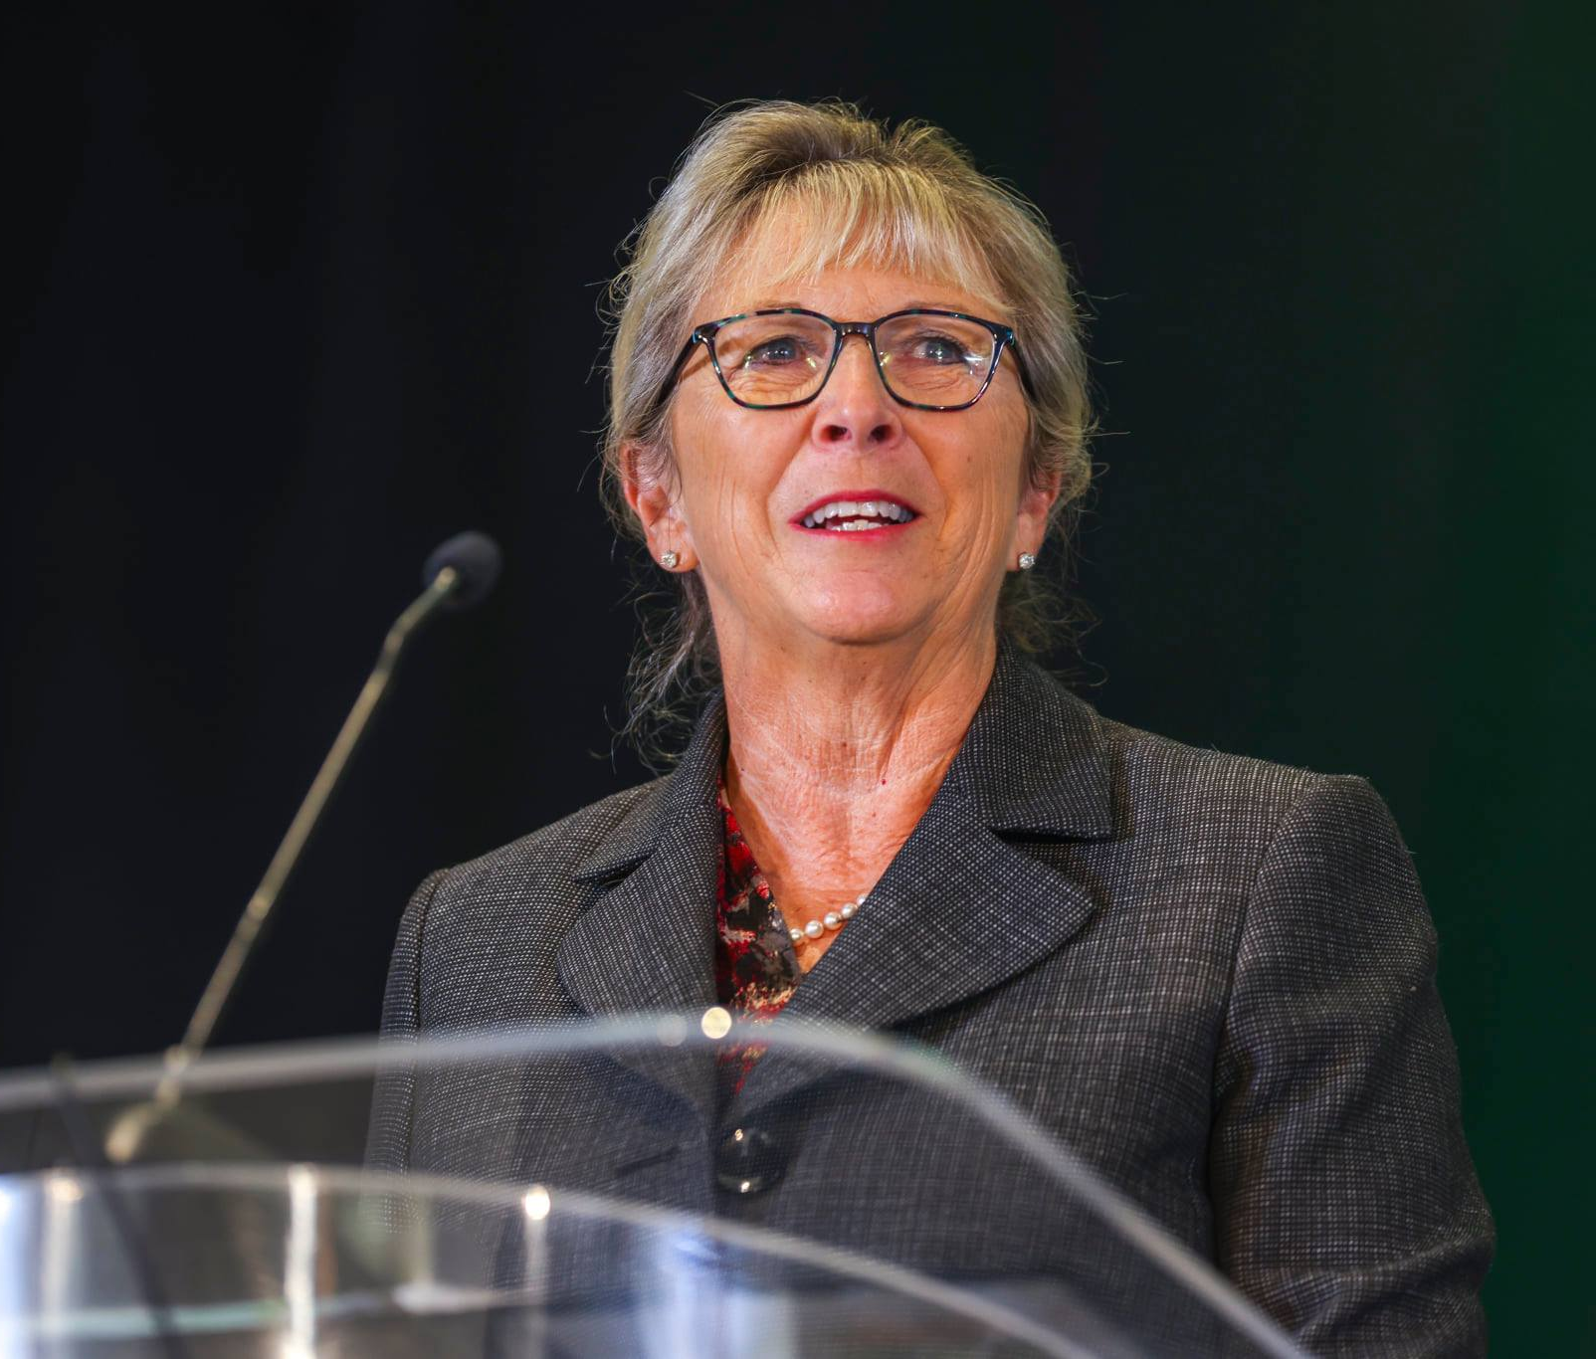
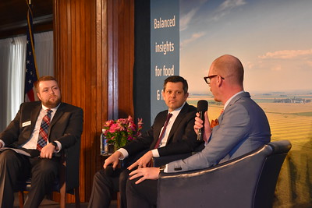
Agri-Pulse Conferences
Participants include legislators, commodity leadership, commodity trade and marketing executives, USDA, ag and food marketing executives, farm organizations, and more.
Agri-Pulse Ag & Food Policy Summit
March 17, 2025 – Washington D.C. Virtual & in-person event with average attendance of 750+
A full day program of high-level discussions, panels and presentations addressing the most critical ag and food policy issues of the day, followed by the Agri-Pulse customer appreciation reception and networking opportunities
Agri-Pulse WEST Food & Ag Issues Summit
June 10, 2025 – Sacramento, CA. Virtual & in-person event with average attendance of 450+
A full-day program with informative presentations and panel discussions followed by the Agri-Pulse customer appreciation reception and networking opportunities
Ag Outlook Forum
TBD- 2025 – Kansas City, MO. Virtual & in-person event with average attendance of 350+
A joint venture with the Agricultural Business Council of Kansas City
Day-long conference focusing on the ag economy, current issues and challenges facing agriculture and agribusiness, plus networking opportunities

Slide 16
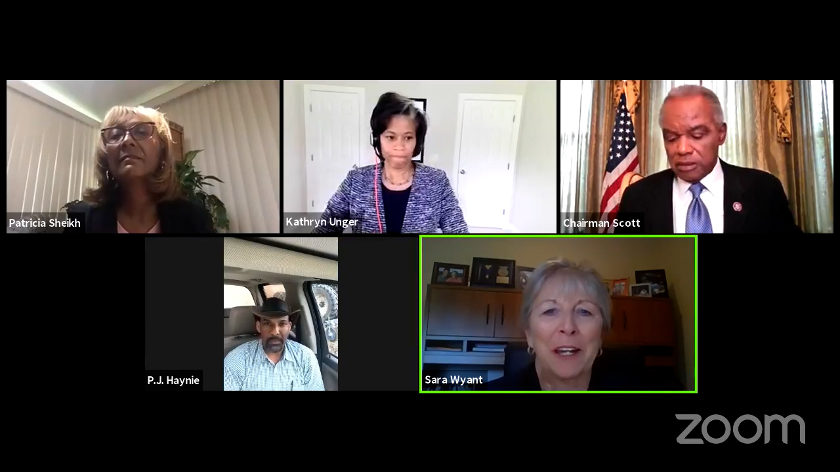
Webinars
A custom-produced, one-hour webinar with mutual collaboration on content/theme between sponsor and Agri-Pulse
Typical format is a panel discussion/presentation followed by Q & A
Managed & moderated by Agri-Pulse
Potential to reach the Agri-Pulse 75,000+ person database
Promotions & invitations provided by Agri-Pulse to target audiences
All technical, registration and platform support provided
Webinar content is jointly owned by Agri-Pulse and sponsor
Webinar is recorded for potential future use by the sponsor
Sponsor recognition included in all promotions/invitations
List of registered participants provided to the sponsor
Webinar promotion on home page of www.Agri-Pulse.com prior to the event
Net cost $16,000* Includes website ads before or after the event * Minimum 30-day notice required. Any changes to elements as outlined may incur additional costs

Slide 17
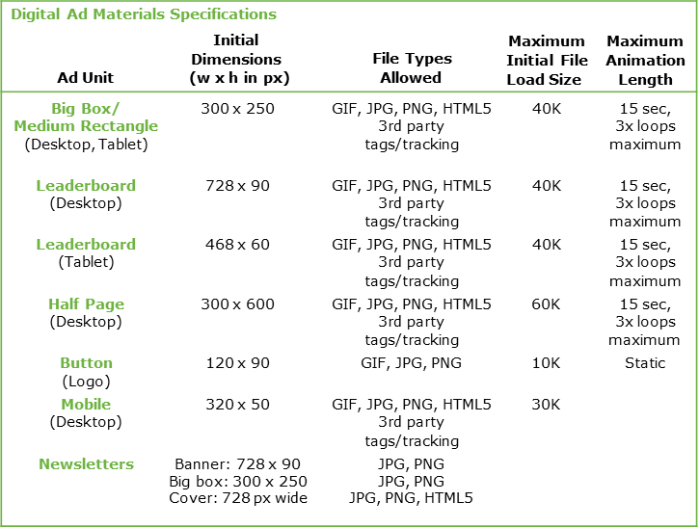
Advertising Rates 2025
NEWSMAKERS
Length
Price Per Month
Price Per Week
HOME PAGE
Size Price Per Month
30/15 second spots
$10,000
$11,500
$3,000
$3,750
Top/Bottom Leaderboard Combo
Open Mic* Opinion
Newsmakers
Agri-Pulse TV Lower Half Page
728 x 90
300 x 250
300 x 250
300 x 250
300 x 250
300 x 600
$3,337
$10,977
$7,877
$7,877
$3,997
$3,997
Agri-Pulse only
Agri-Pulse/RFD TV Combo
*Multiple week discounts available
MEET THE LAWMAKER OR FARMHAND VIDEO
Length
Price Per Month
Meet the Lawmaker or Farmhand
30-second pre-roll
$2,617
Open Mic, Opinion & Newsmakers appear on all web pages
*Includes 60 sec script
DAILY HARVEST
Price Per Month
ARTICLE/NEWS PAGES
Size
Price Per Month
National Leaderboard
West Leaderboard
Combo
728 x 90 banner appearing in email
$6,587
$3,937
$9,477
Top/Bottom Leaderboard Combo
Big Box Lower Half Page
728 x 90
300 x 250
300 x 600
$7,667
$3,997
$3,997
WEBINARS
LEGISLATIVE COVERS
Size
Price Per Month
Custom webinar in partnership with your company
$16,000
Hill Staff Cover (DC)
The Building Cover (CA)
728 pix wide
728 pix wide
$2,200
$2,000
Includes $5,000 in website advertising
INSTANT UPDATES
Price Per Month
728 x 90 banner appearing in email
Exclusive sponsorship
Multiple daily exposures
Delivered 4,500+ readers
$8,277
DRIVETIME
Size
Price Per Month
Price Per Week
DriveTime Sponsor*
120 x 90
$9,877
$2,747
*Includes 30-second spot. Sponsor banner link (728 x 90) included with daily e-blast. Will appear on all web pages. Additional $500 for weekly sponsorship option.

Slide 18
To reach agriculture’s premier policy makers and business leaders, put the Agri-Pulse family of information services to work for you.
For marketing solutions, ideas and pricing, contact:
Jason Lutz – jason@agri-pulse.com Tom Davis – tomdavisrmg@outlook.com
Allan Johnson – allan@agri-pulse.com
Hannah Fonseca – hannah@agri-pulse.com
Agri-Pulse West: Burke Kennedy – burke@agri-pulse.com
For subscription information, contact:
Paige Dye – paige@agri-pulse.com
(573) 873-0800 | www.agri-pulse.com

